Slide 1

BILLIONAIRES STATISTICS ANALYSIS WITH SQL AND EXCEL

Slide 2
INTRODUCTION
This dataset contains statistics on the world's billionaires, including information about their businesses, industries, and personal details. It provides insights into the wealth distribution, business sectors, and demographics of billionaires worldwide

Slide 3

finalWorth: The final net worth of the billionaire in U.S. dollars.
rank: The ranking of the billionaire in terms of wealth.
category: The category or industry in which the billionaire's business operates.
personName: The full name of the billionaire.
age: The age of the billionaire.
country: The country in which the billionaire resides.
city: The city in which the billionaire resides.
source: The source of the billionaire's wealth.
industries: The industries associated with the billionaire's business interests.
selfMade: Indicates whether the billionaire is self-made (True/False).
gender: The gender of the billionaire.

Slide 4
birthDate: The birthdate of the billionaire.
lastName: The last name of the billionaire.
firstName: The first name of the billionaire.
birthYear: The birth year of the billionaire.
birthMonth: The birth month of the billionaire.
birthDay: The birth day of the billionaire.
cpi_country: Consumer Price Index (CPI) for the billionaire's country.
gdp_country: Gross Domestic Product (GDP) for the billionaire's country.
life_expectancy_country: Life expectancy in the billionaire's country.
tax_revenue_country_country: Tax revenue in the billionaire's country.
total_tax_rate_country: Total tax rate in the billionaire's country.
population_country: Population of the billionaire's country.

Slide 5
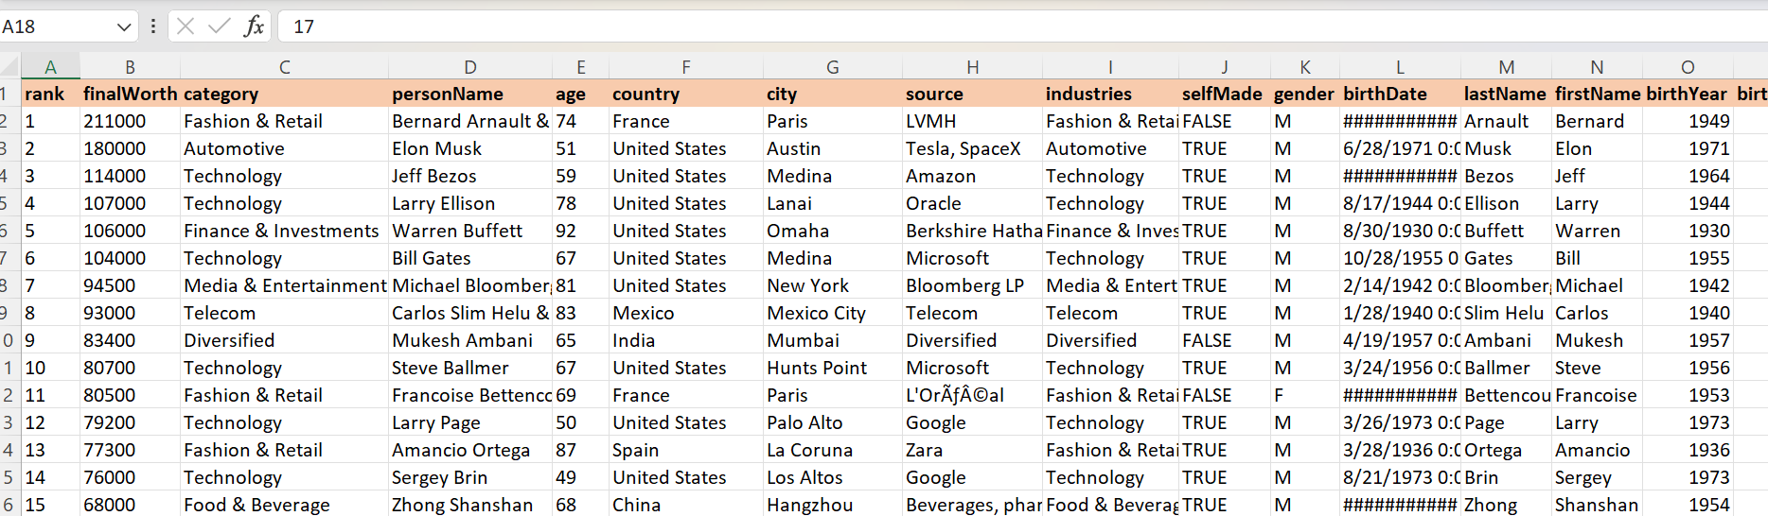
Select Billionaires Data
SELECT
finalWorth,category,personName,age,country,city,source,
industries,selfMade,gender,birthdate,lastName,firstName,birthyear
FROM class.`billinaiers data`;

Slide 6
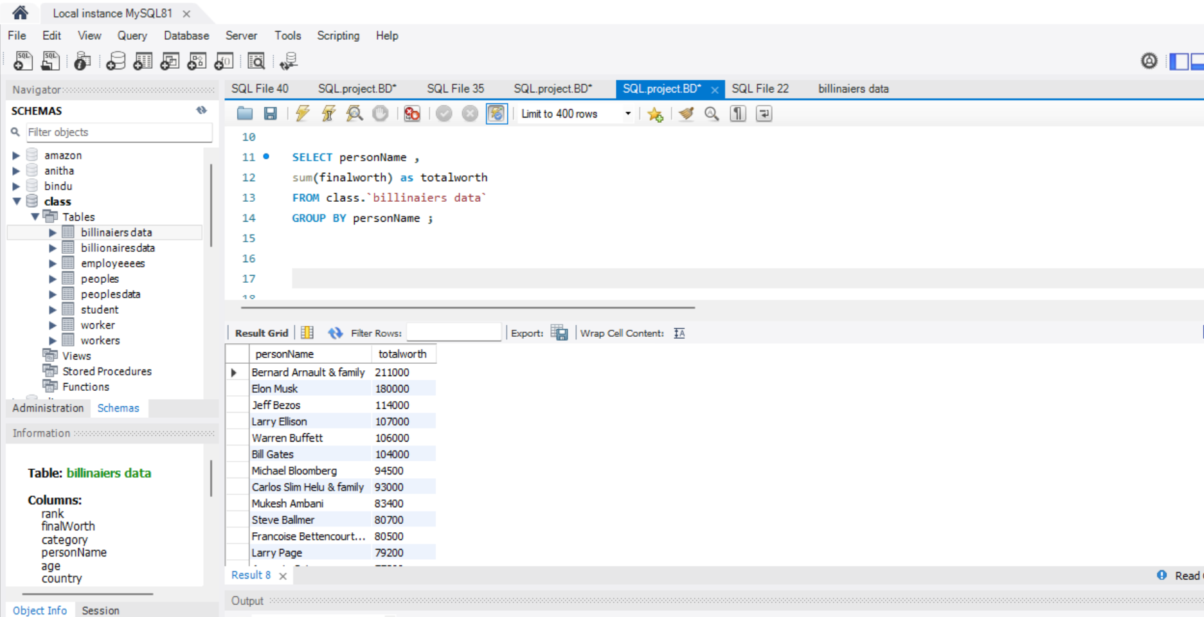
PERSONNAME & TOTALWORTH
SELECT personName ,
sum(finalworth) as totalworth
FROM class.`billinaiers data`
GROUP BY personName ;

Slide 7
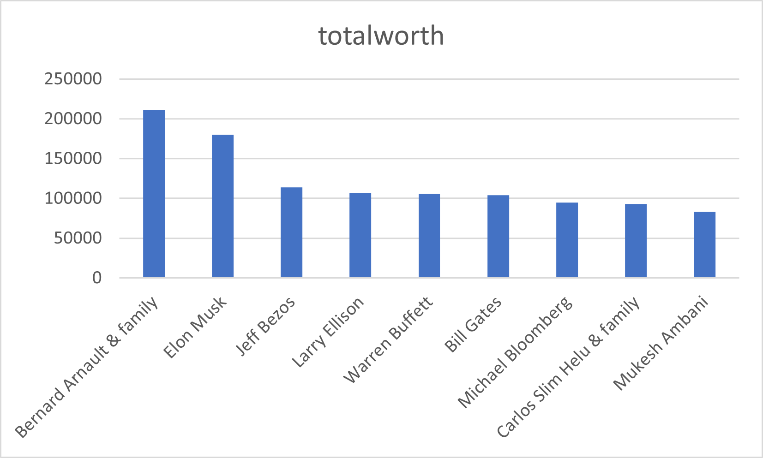
PERSONNAME & TOTALWORTH

Slide 8
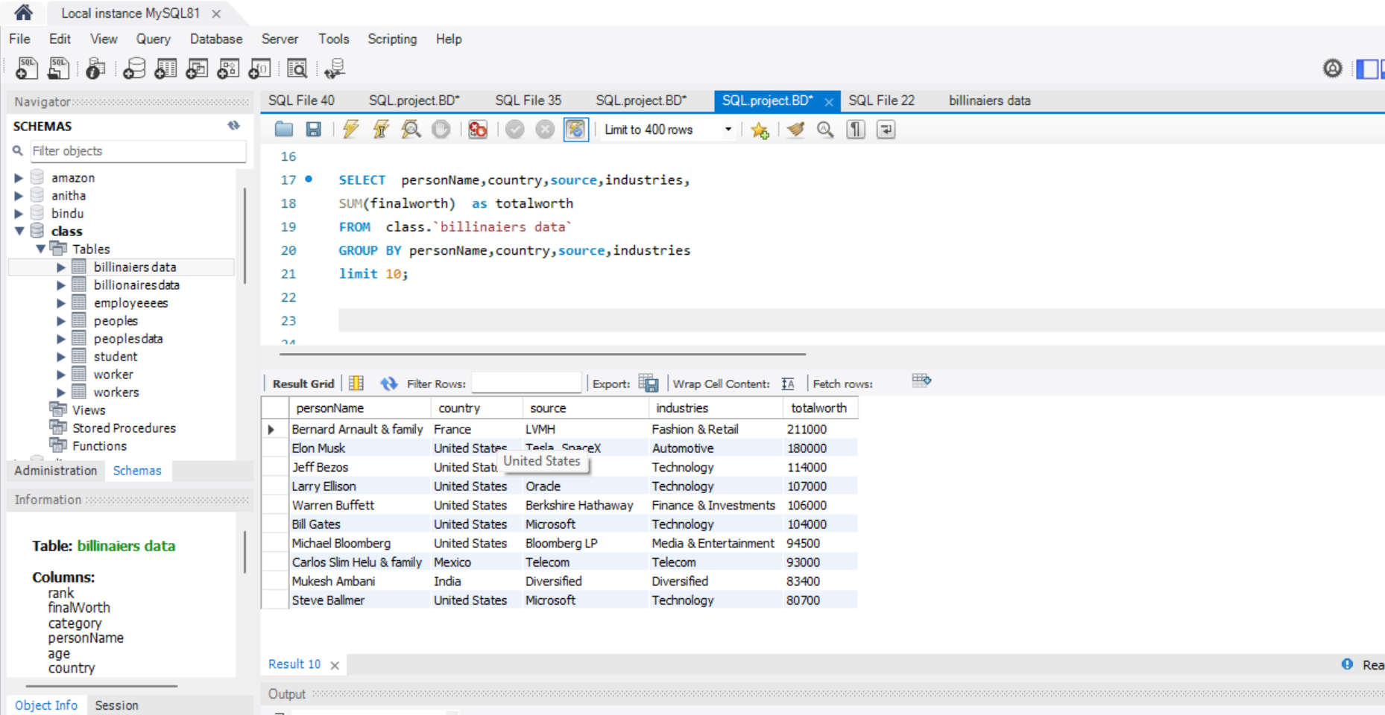
TOTAL WORTH
SELECT personName,country,source,industries,
SUM(finalworth) as totalworth
FROM class.`billinaiers data`
GROUP BY personName,country,source,industries
limit 10;

Slide 9
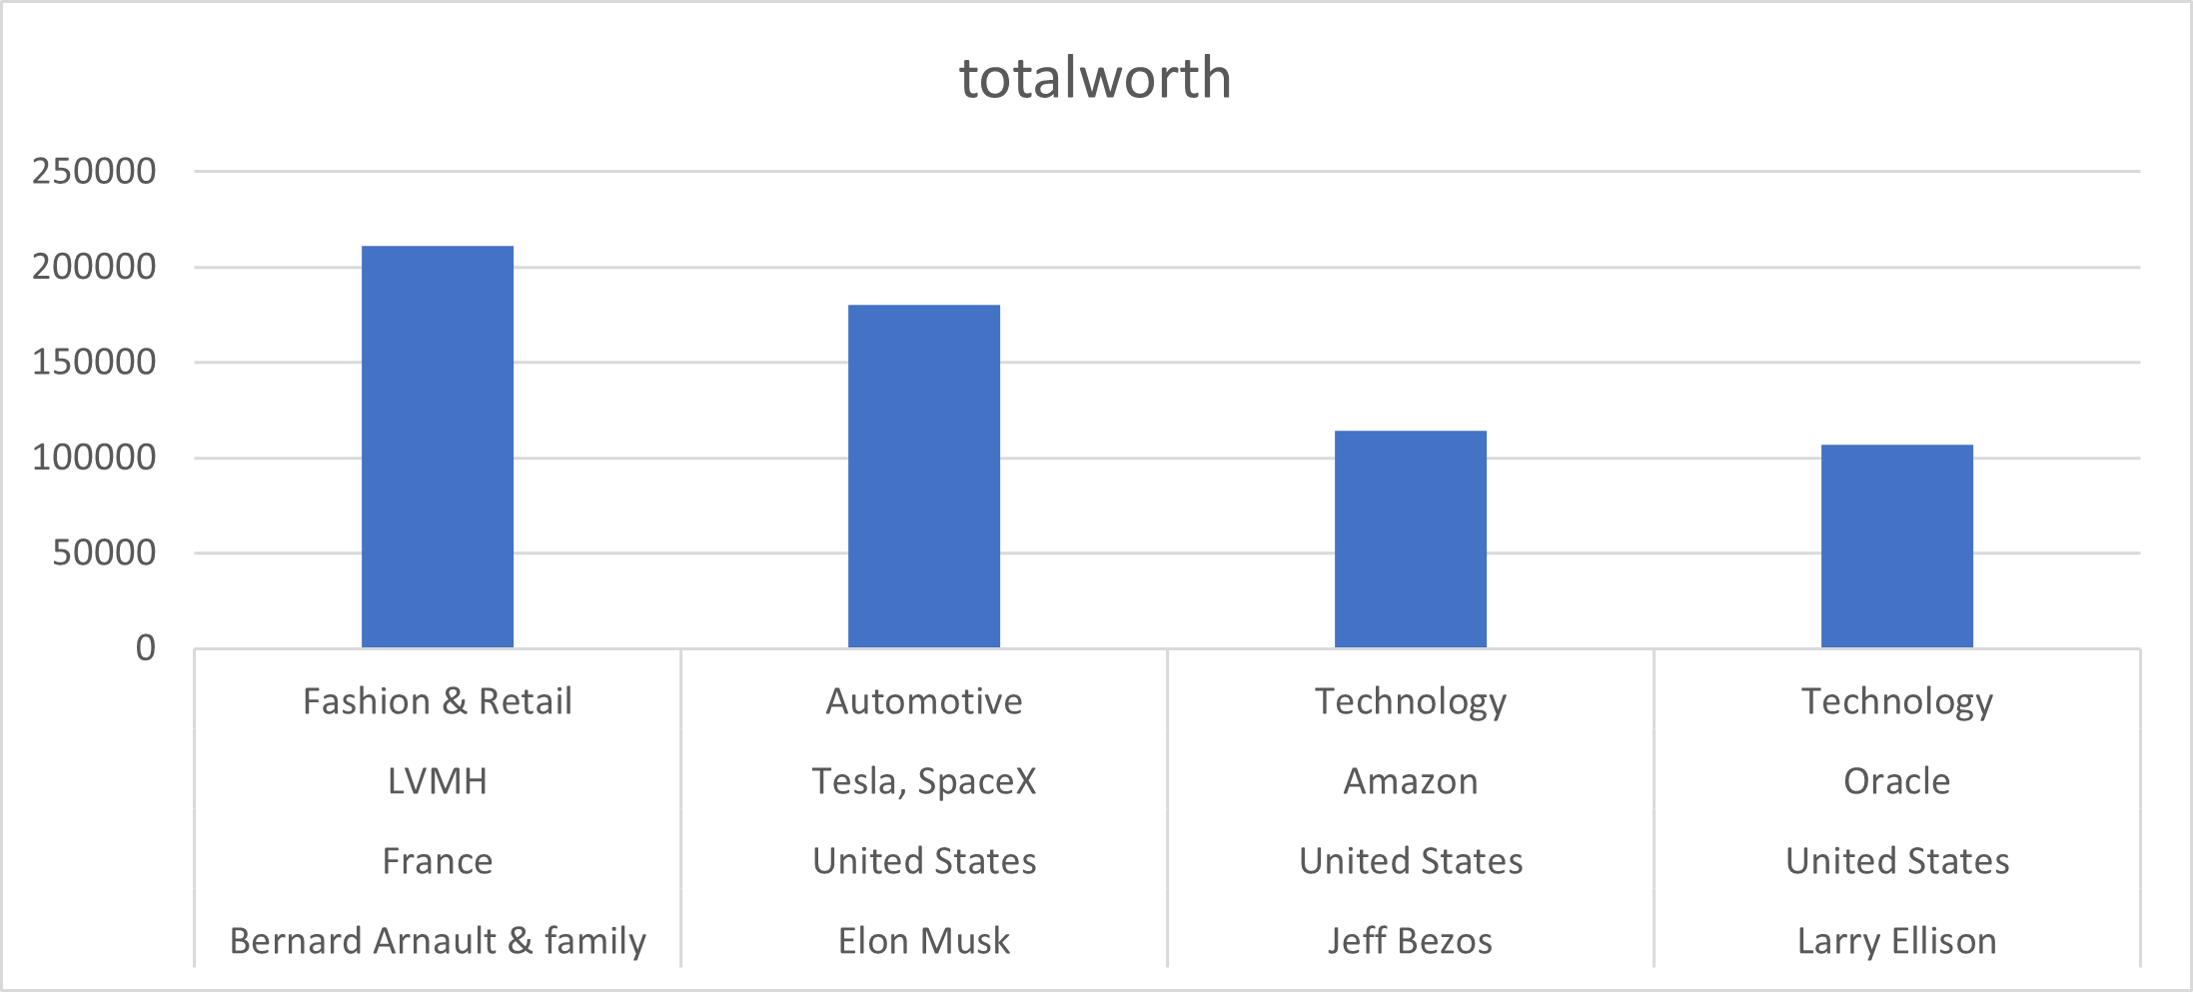
Total worth with personName,country,industries,source
→totalworth
→source,industries,country,personname

Slide 10
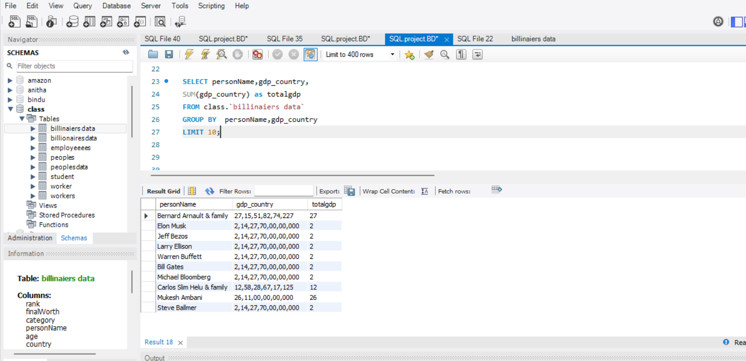
Total gdp_country
SELECT personName,gdp_country,
SUM(gdp_country) as totalgdp
FROM class.`billinaiers data`
GROUP BY personName,gdp_country
LIMIT 10;

Slide 11
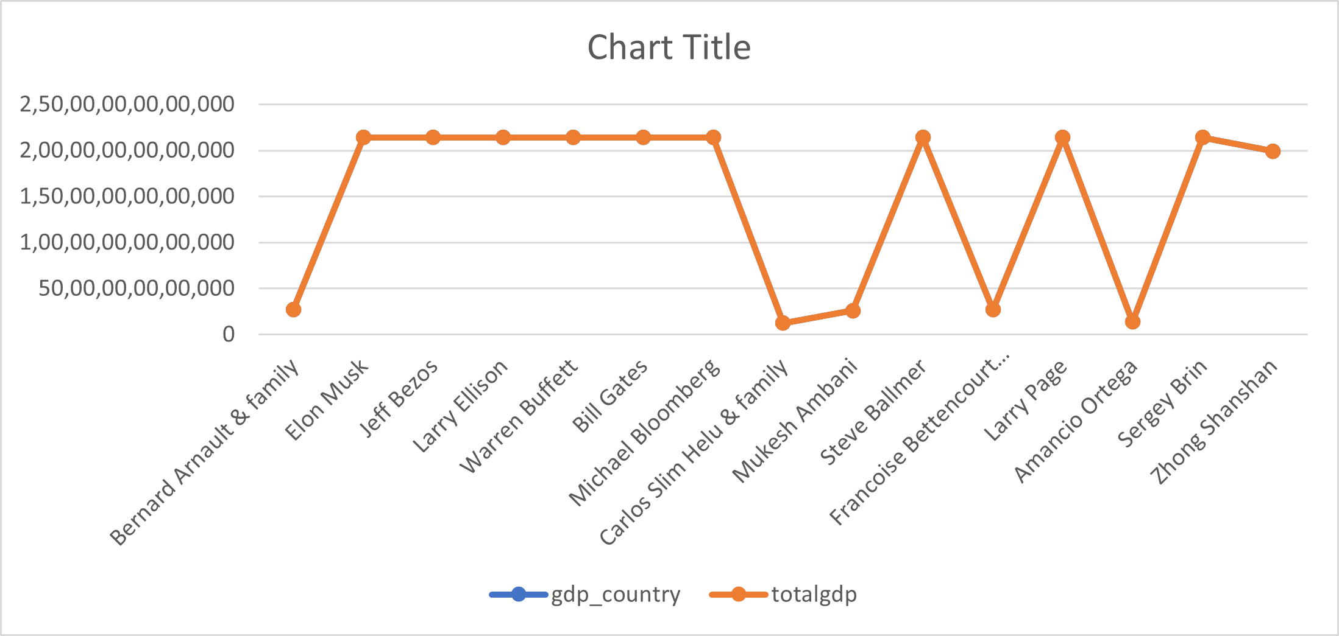
TOTAOL GDP_COUNTRY

Slide 12
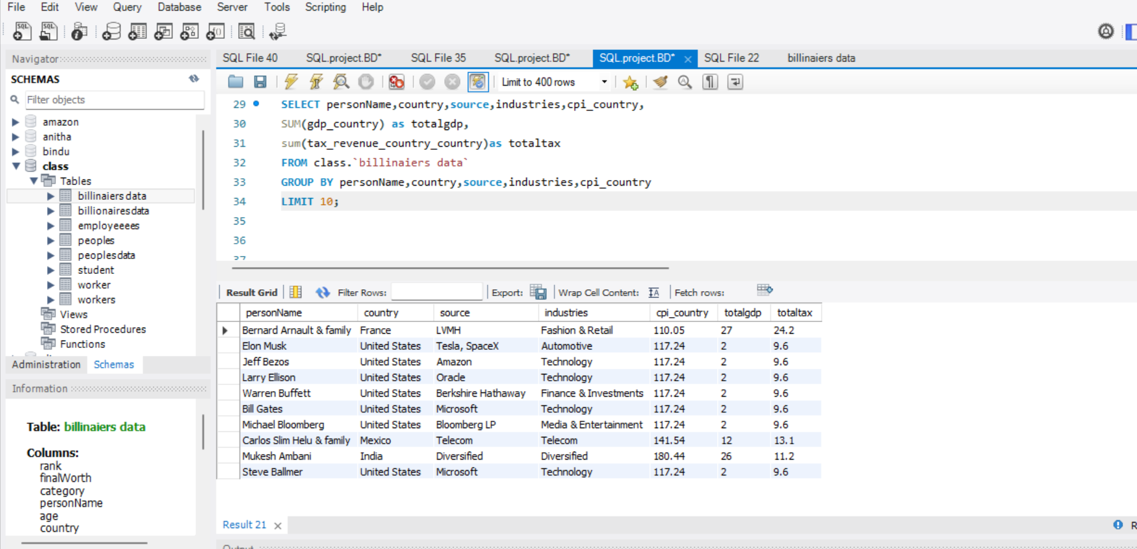
TOTAL GDP_COUNTRY & TAX_REVENUE
SELECTpersonName,country,source,industries,cpi_coutry,
SUM(gdp_country) as totalgdp,
SUM(tax_revenue_country_country)as totaltax
FROM class.`billinaiers data`
GROUP BY personName,country,source,industries,cpi_country
LIMIT 10;

Slide 13
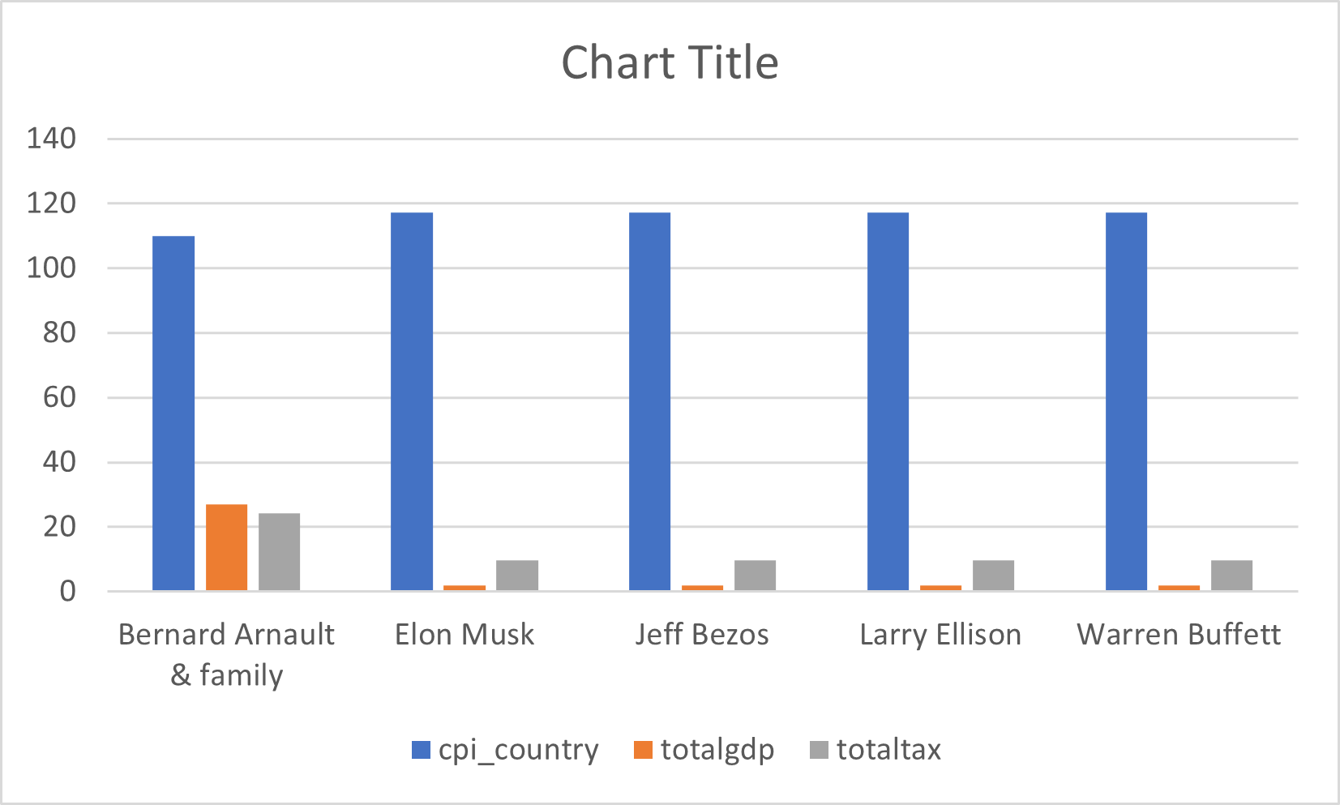
TOTAL GDP_COUNTRY & TAX_REVENUE

Slide 14
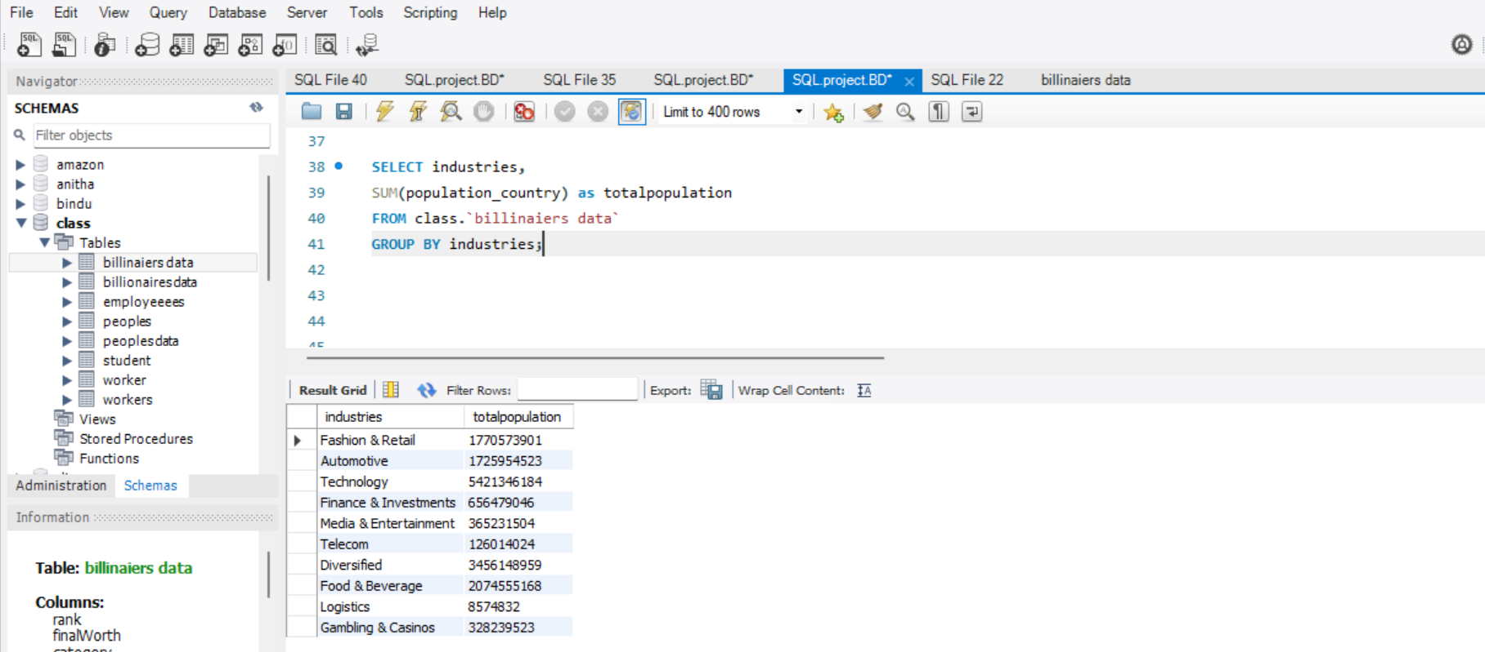
TOTAL POPULATION
SELECT industries,
SUM(population_country) as totalpopulation
FROM class.`billinaiers data`
GROUP BY industries;

Slide 15
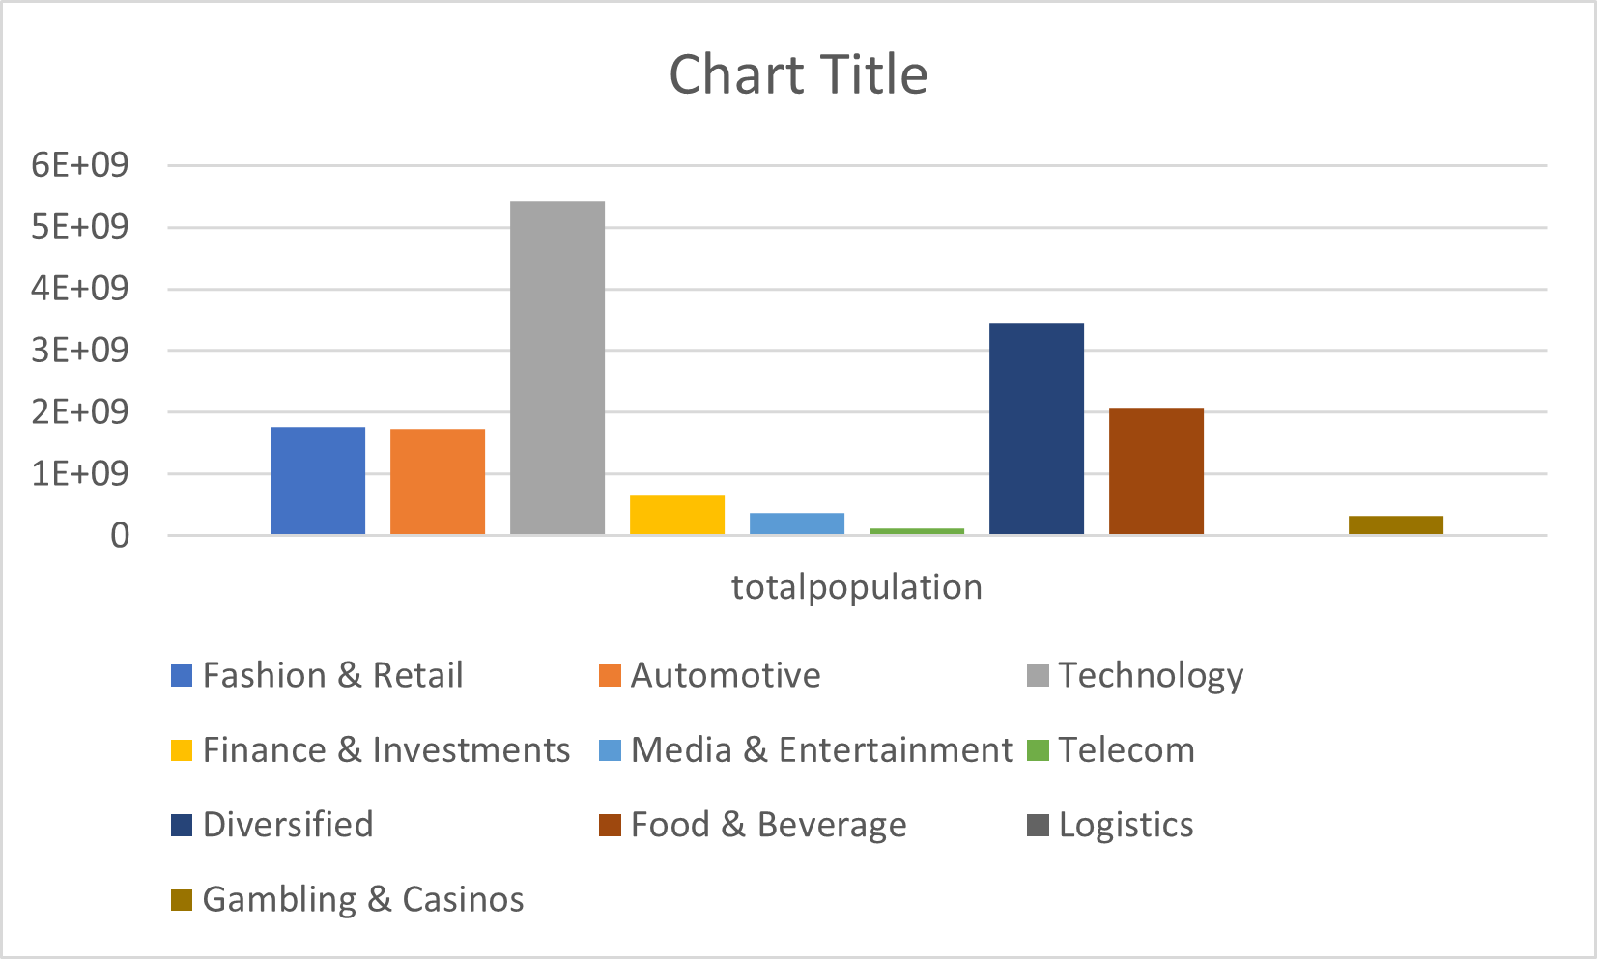
TOTAL POPULATION

Slide 16
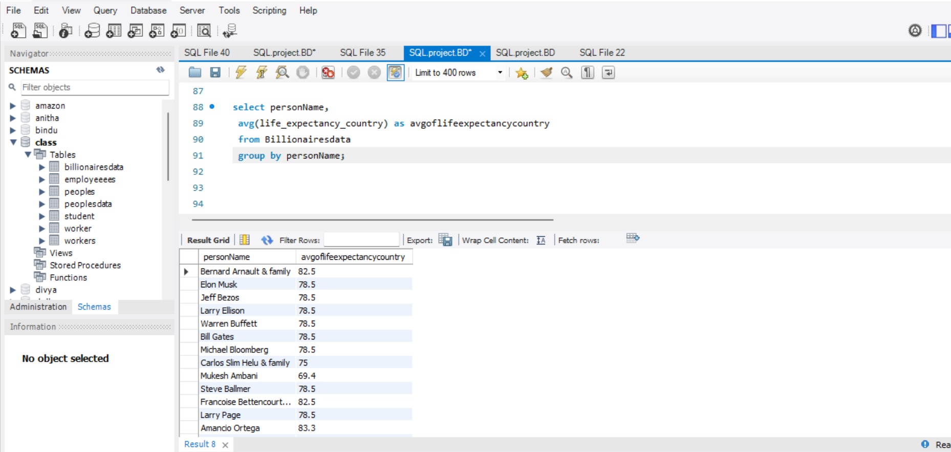
AVERAGE LIFE_EXPECTANCY_COUNTRY
SELECT personName,
AVG(life_expectancy_country) as avgoflifeexpectancycountry
FROM class.`billinaiers data`
GROUP BY personName
LIMIT 10;

Slide 17
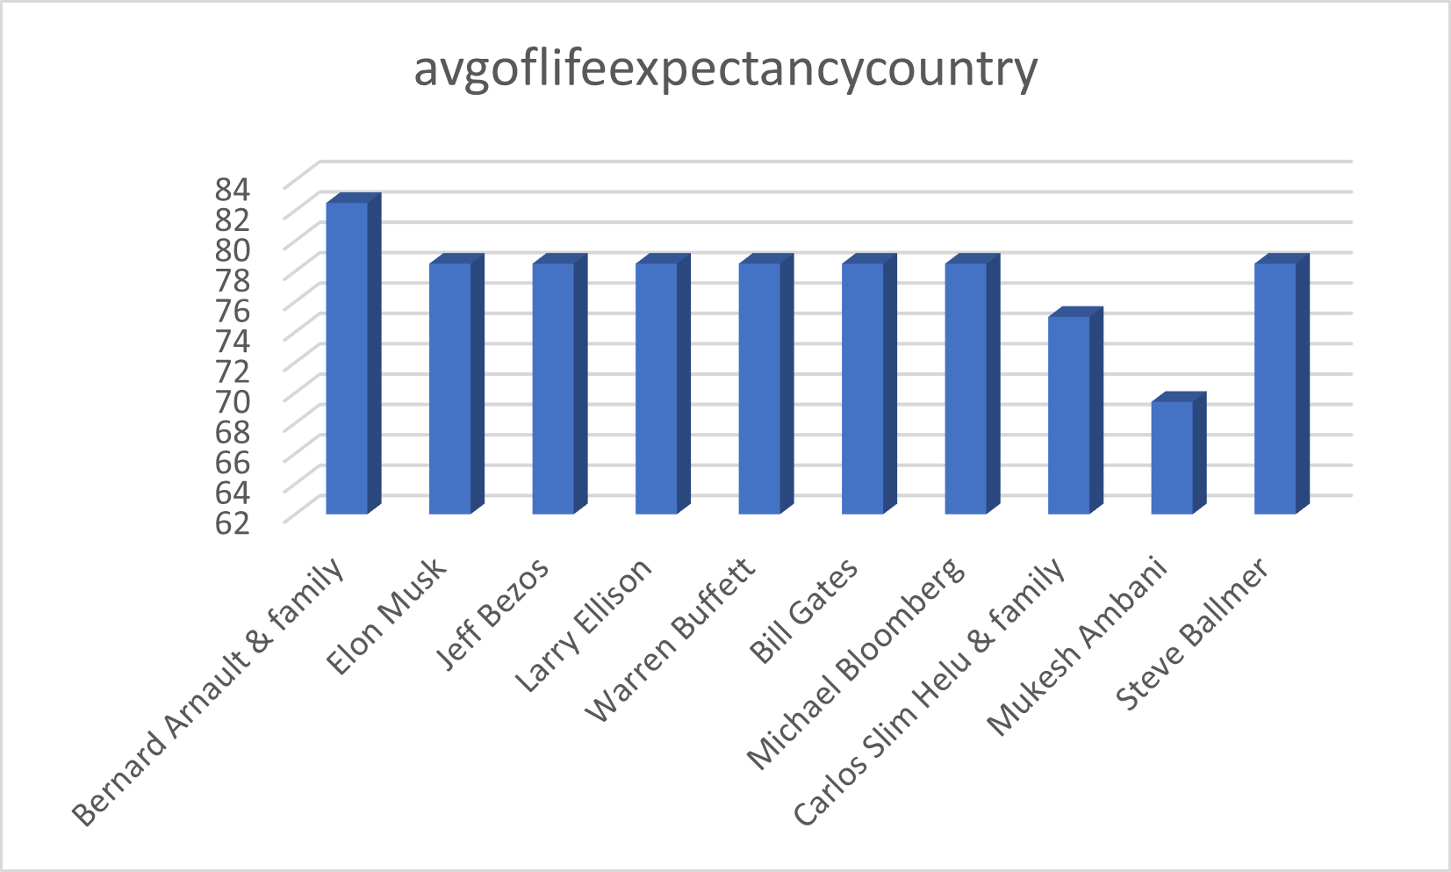
AVERAGE LIFE_EXPECTANCY_COUNTRY

Slide 18
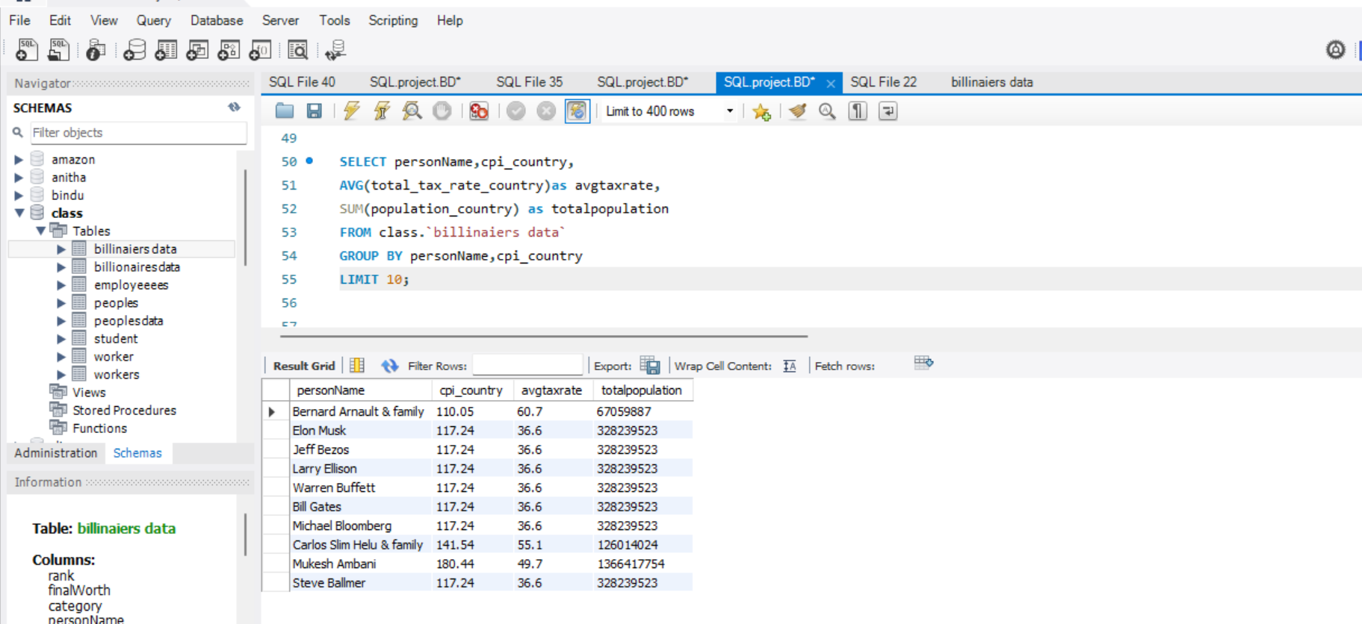
AVERAGE TAX & TOTAL POPULATION
SELECT personName,cpi_country,
AVG(total_tax_rate_country)as avgtaxrate,
SUM(population_country) as totalpopulation
FROM class.`billinaiers data`
GROUP BY personName,cpi_country
LIMIT 10;

Slide 19
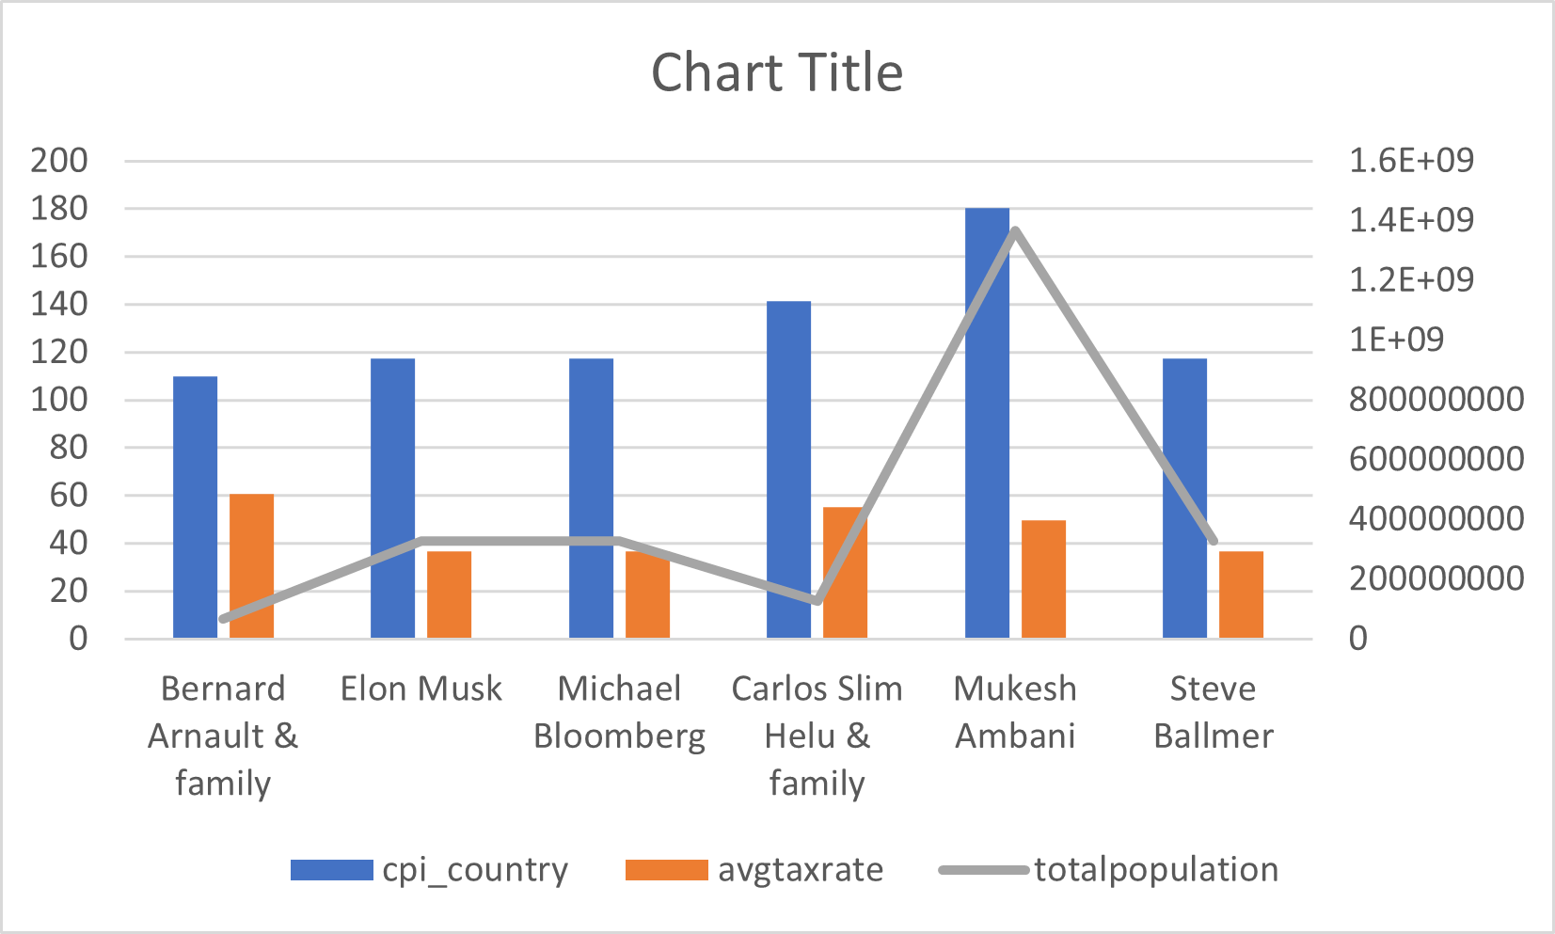
AVERAGE TAX & TOTAL POPULATION

Slide 20
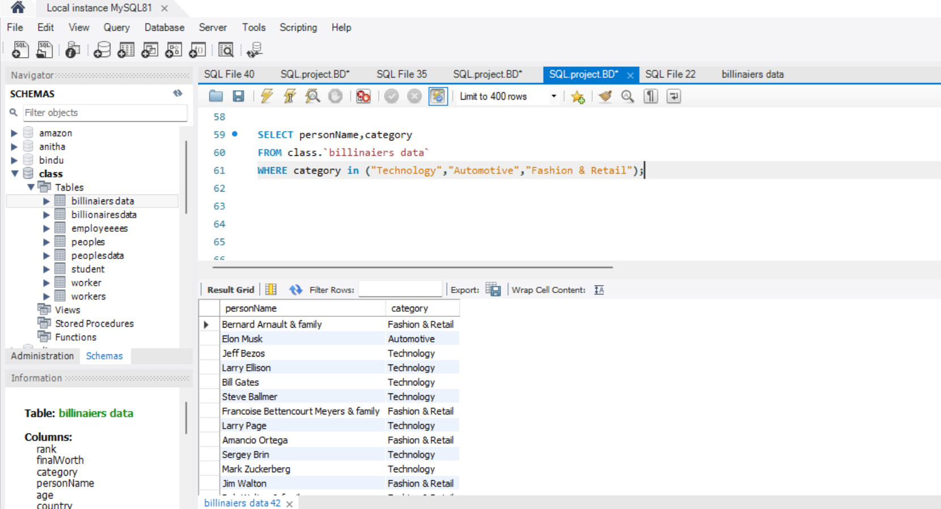
CATEGORY
SELECT personName,category
FROM class.`billinaiers data`
WHERE category in ("Technology","Automotive","Fashion & Retail");

Slide 21
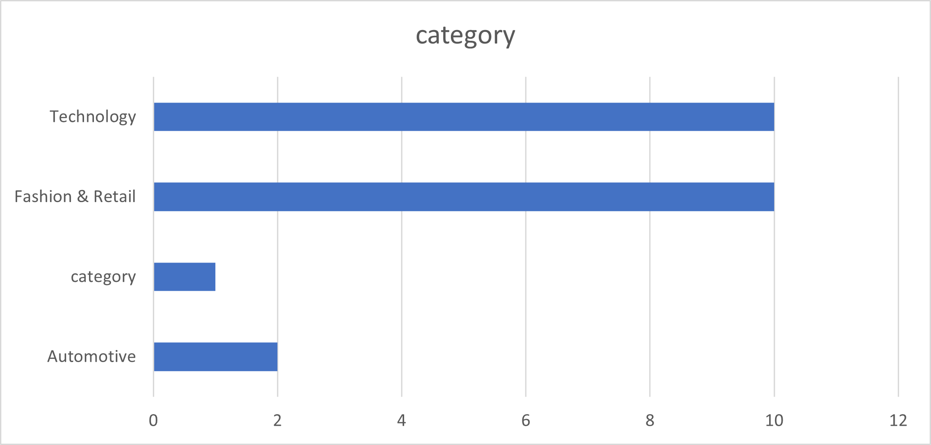
CATEGORY
→Persons count as category

Slide 22
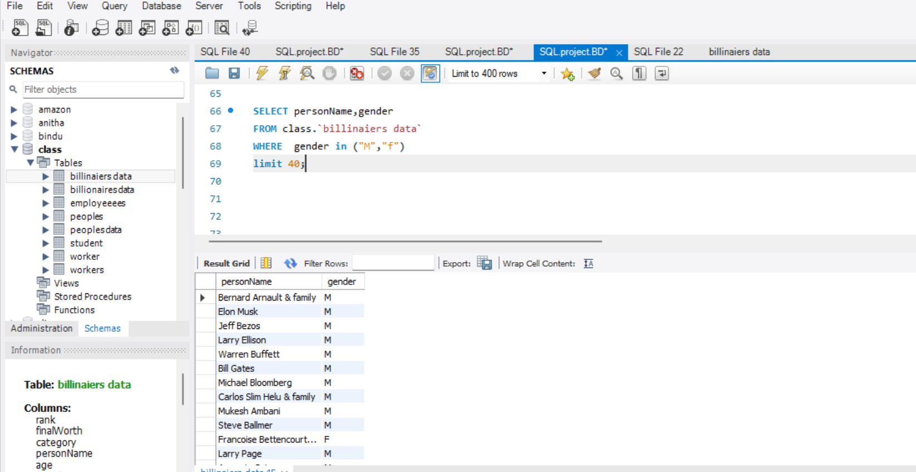
PERSONNAME & GENDER
SELECT personName,gender
FROM class.`billinaiers data`
WHERE gender in ("M","f")
LIMIT 40;

Slide 23
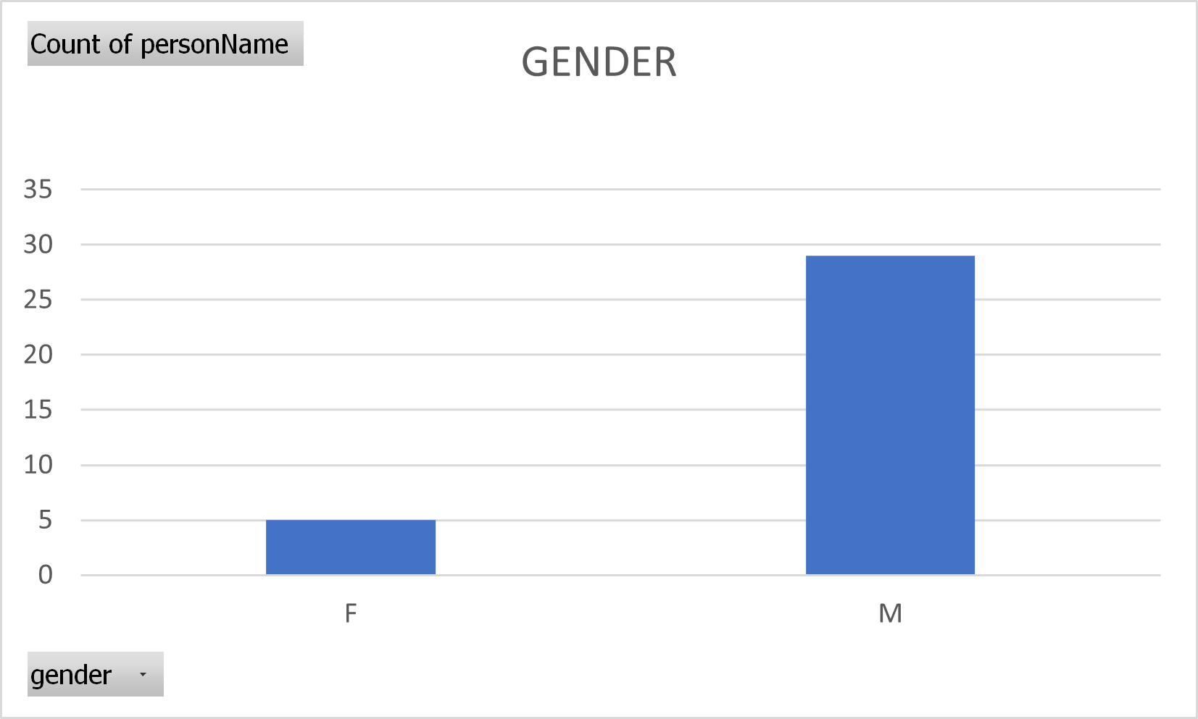
GENDER

